Slide 1


KEYLOGGER AND SECURITY
--G.ANAND BALAJI

Slide 2

KEY LOGGER
A keylogger is a programme or tool designed to monitor and keep a tab on the “keystrokes” made on the user keyboard.
This enables on compromising sensitive data like passwords etc..

Slide 3

Project analysis slide 6
AGENDA
The Main Agenda of the Keylogger experiment is to demonstrate how key logger works and to prevent it and how to create a key logger in real time .
An introduction highlighting the importance of keyloggers, followed by a detailed exploration of project objectives, technical intricacies of key press capture, and the functionality of logging keystrokes to both text and JSON files.
The agenda includes a demonstration of the GUI interface, a discussion on ethical considerations surrounding keyloggers, and a live showcase of the keylogger in operation.

Slide 4

Project analysis slide 7
PROBLEM STATMENT
Develop a sophisticated keylogger using Python, integrating the `pynput` library for key press monitoring and a user-friendly GUI designed with `tkinter`. The key objective is to create a secure and efficient keylogging tool that can accurately record and store keystrokes in various file formats. This endeavor seeks to address the need for a reliable keylogging solution that balances technical complexity with user accessibility, ensuring data integrity and ethical usage in the realm of cybersecurity and software development.

Slide 5
Project analysis slide 8
Project Overview
This project investigates keyloggers, malicious tools that covertly record keystrokes to capture sensitive information. The study aims to understand their operation, evaluate detection methods, and develop prevention strategies
.
Objectives:
Understand keylogger mechanisms.
Evaluate detection tools and techniques.
Develop and test prevention strategies.
Address ethical and privacy considerations.

Slide 6

Project analysis slide 10
Project Overview
Methodology:
Setup: Configure test environments with selected keyloggers.
Experimentation: Install keyloggers and monitor captured data.
Detection: Test various detection tools for accuracy.
Prevention: Implement and assess security measures to prevent keylogger installation.
Data Analysis: Analyze collected data to determine effectiveness.

Slide 7
Project analysis slide 11
End users of kelogger
End Users of Keyloggers
Cybercriminals:
Purpose: Steal sensitive information for financial gain or identity theft.
Corporate Espionage Agents:
Purpose: Obtain trade secrets and business strategies for competitive advantage.
Law Enforcement and Intelligence Agencies:
Purpose: Monitor suspects for criminal investigations and national security.
Employers:
Purpose: Monitor employees to prevent data leakage and ensure productivity.
Parents:
Purpose: Monitor children's online activities for safety.
Security Researchers:
Purpose: Study keylogger behavior to improve detection and prevention.
Self-Monitoring Users:
Purpose: Track personal typing activities for productivity or data recovery.

Slide 8
BENEFITS OF KEY LOGGER
Intrusion Detection: Keyloggers can be used as a part of intrusion detection systems to monitor user activity and detect suspicious behavior.
Forensic Analysis: Keyloggers can be valuable tools for digital forensic investigators when analyzing security incidents or investigating cybercrimes.
Security Research and Testing: Ethical hackers and security researchers may use keyloggers as part of penetration testing and vulnerability assessments to evaluate the security of systems and applications. By simulating real-world attack scenarios, they can identify weaknesses and recommend mitigations.

Slide 9
Disadvantages of key logger
Privacy Invasion: Keyloggers have the potential to infringe on individuals' privacy by capturing sensitive information, such as passwords, personal messages, and browsing history, without their consent or knowledge.
Misuse and Abuse: Keyloggers can be misused for malicious purposes, such as stealing passwords, financial information, or intellectual property, leading to identity theft, financial fraud, or corporate espionage.
Legal and Ethical Concerns: The use of keyloggers without proper authorization or consent may violate privacy laws and ethical principles, resulting in legal repercussions and damage to reputation if discovered.
Security Vulnerabilities: Keyloggers themselves can become targets for exploitation by cybercriminals, leading to security vulnerabilities and potential breaches if not properly secured or maintained.
Cost and Complexity: Implementing comprehensive security measures can be costly and complex, requiring investment in software, hardware, personnel training, and ongoing maintenance.

Slide 10
YOUR SOLUTION AND ITS VALUE PROPOSITION
Anti-Key-logger – As the name suggest these are the software which are anti / against key loggers and main task is to detect key-logger from a computer system.
Anti-Virus – Many anti-virus software also detect key loggers and delete them from the computer system. These are software anti-software so these can not get rid from the hardware key-loggers.
Automatic form filler – This technique can be used by the user to not fill forms on regular bases instead use automatic form filler which will give a shield against key-loggers as keys will not be pressed .
One-Time-Passwords – Using OTP’s as password may be safe as every time we login we have to use a new password.
Patterns or mouse-recognition – On android devices used pattern as a password of applications and on PC use mouse recognition, mouse program uses mouse gestures instead of stylus.
Voice to Text Converter – This software helps to prevent Keylogging which targets a specific part of our keyboard.

Slide 11
Modelling
Import Required Modules:
Use Python's keyboard module to capture keystrokes.
Optionally, use other modules for logging, encryption, or network communication.
Set Up Logging:
Configure logging settings to specify the format and destination of log files.
Define Keylogger Function:
Create a function to capture and log keystrokes.
Use the keyboard.on_press() method to register a callback function to capture each key press event.
Main Function:
Create a main function to start the keylogger and keep it running indefinitely.
Testing and Deployment:
Test the keylogger program to ensure it captures keystrokes correctly.
Deploy the keylogger on target systems if necessary, ensuring compliance with legal and ethical considerations.

Slide 12

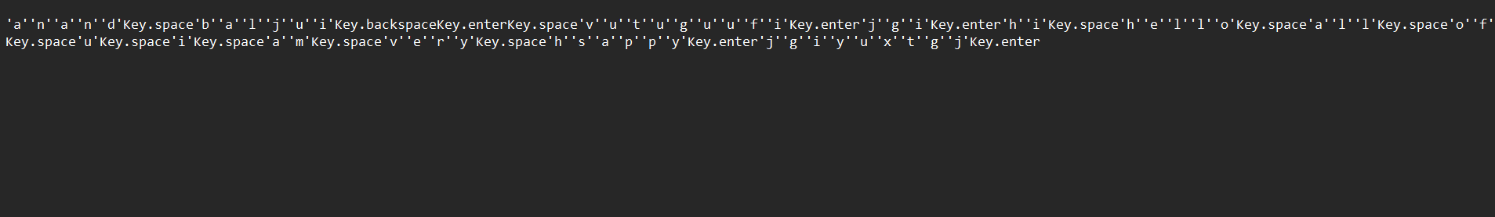
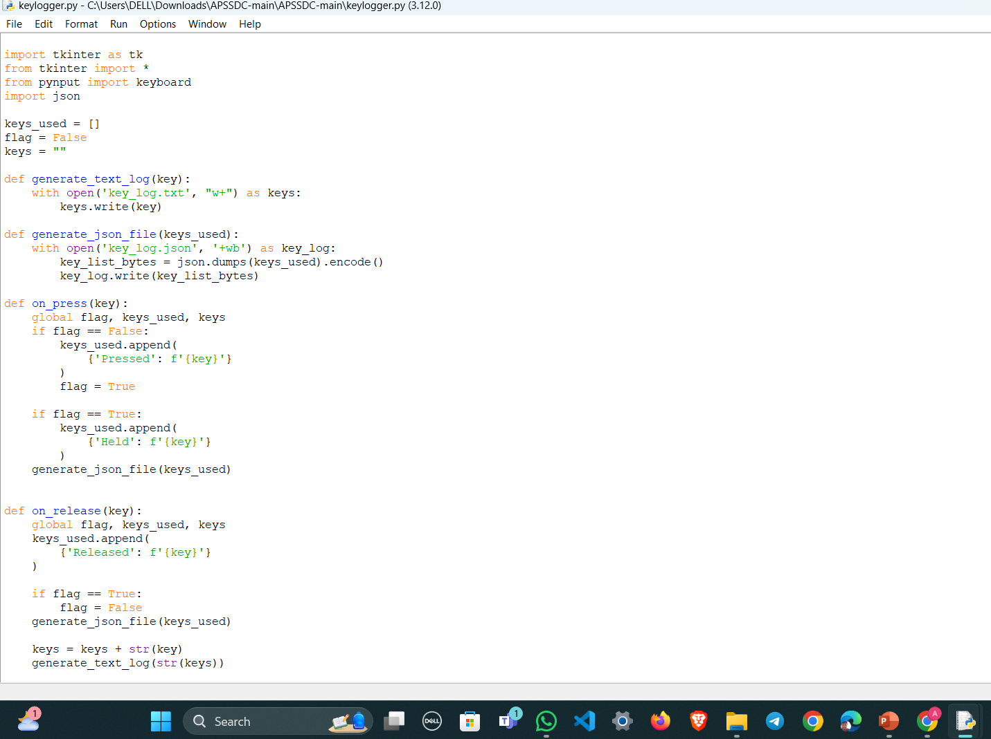
RESULTS

Slide 13
Results
Results:
Insights into keylogger functionality and effectiveness.
Evaluation of detection tools and their reliability.
Recommendations for robust preventive measures.
Discussion on ethical considerations.
Conclusion: The project aims to enhance keylogger threat understanding, improve detection capabilities, and strengthen preventive measures, contributing to better cybersecurity practices.

Slide 14
Thank You

Slide 15
https://github.com/anandbalaji526533/apcs.git

